Slide 1
Bible Verse Mapping
Digging Deep To Know Our Fathers Heart

Slide 2
The Living Word
John 1: 1-4
In the beginning was the Word, and the Word was with God, and the Word was God. The same was in the beginning with God. All things were made by Him; and without him was not anything made that was made. In Him was life; and the life was the light of men. And the light shineth in darkness; and the darkness comprehended it not.
Notes:
Letters form words; nouns, adjectives, verbs etc…arranged words form sentences. Sentences form concepts and ideas. As humans we use words to advance our sentiments, theories, suppositions, suggestions, opinions and notions. But Jesus came to advance truth.
He is the physical manifestation of the thoughts and truths of God. He is the living, breathing demonstration of the principles of God’s kingdom.
Seeing those heavenly concepts in action in the life of Christ, through the word of God has the power to transform us.
If we are going to reflect Christ, we need to take time to be in His presence, understand His character, and apply the principles of heaven in our everyday lives. Because in Him is life, and His life, is our light.

Slide 3
What is Bible Verse Mapping?
Study method that uses context, cross-reference, translations, dictionaries and other reference materials to dissect verses in order to experience a deeper understanding of the passage.
A foundational element in thorough Bible study and in developing a lasting, meaningful, living and deepening relationship with God.
Verse Mapping reveals God and His character, His encouragement, or His instruction in order to give us a firm Christian/Biblical foundation of faith and practice.
Allows us to deconstruct individual parts of a verse or passage and then put it back together in a systematic way that becomes personal to us.
Versatile
Individualized
Easily incorporates other devotional methods
Give mental vigor to our study time
Notes:
So what is Bible Verse Mapping and how will it help us?

Slide 4
Importance Of Deep Study
Knowing God/His Character
This is life eternal, that they might know thee, the One True God and Jesus Christ, whom Thou has sent
Relationship (Vine/Branches)
Connection, Time
See Him in His word in order to believe that He is love, Build Faith
Growth
In our obedience
Change/Reflecting Christ
Producing fruit of the Spirit
Victory/Overcoming
Witnessing
Watch/Warn
Preparation for Trial/End Times

Slide 5
Impact of Deep Study
Improved knowledge of God/spiritual things, discernment
Personal communion and conversation with God
Past and present experiences seen through the lens of God’s word
Relevance to everyday life
Purpose
Faith
Witnessing/Teaching
Preparation for trial
Personal growth and victory

Slide 6
Hindrances to Deep Study
Time/too busy
Distractions
Worldly distortions/impersonations (Evil=Good, Good=Evil)
Cloudy brain/bodies
Overstimulated/understimulated
Dulling of processing abilities/reason from cause to effect
Fast-Food/Drive Thru Mentality-devotionals replace study
Shortening of language/icons/emojis/texting
Study is a skill…must be taught/learned
Lack of interest
Sin

Slide 7
What Do I Need to Get Started? *Basic Necessities
Your Bible*
Pen or pencil*
Other versions/translations of the Bible/Parallel Bible
Bible Reading Plan
Verse Map Template or Paper*
Strong’s Concordance*
Bible Dictionary
Thesaurus
EGW Dictionary, EGW Encyclopedia, EGW App
Highlighters, Colored Pencils, Crayons (if you choose to use them).
Journal
Google/Internet

Slide 8
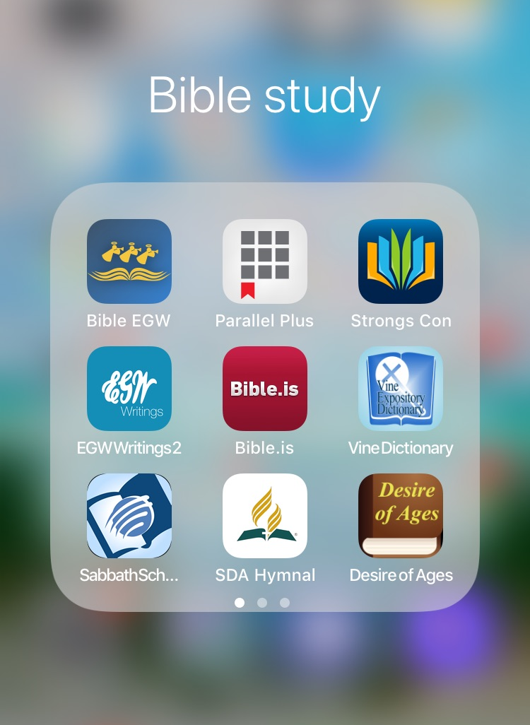
Study Apps Every Phone Should Have
Bible (w/EGW Commentary)
EGW Writings 2
Sabbath School Quarterly
Parallel Plus Bible
Audio Bible
SDA Hymnal
Bible Dictionary
Strong’s Concordance
Vine Bible Dictionary
Desire of Ages
Bible Reading Plan

Slide 9
What to Study?
Bible Reading Plan
Sabbath School Quarterly
Verses of Interest
Topic of Interest
Sermon Notes
People/Places
Favorite Bible Stories

Slide 10
Study Rules
Use the Whole Bible
Bible does NOT contradict itself
Bible interprets itself
Principles are universal (apply in all times/places/cultures)
Context
Who, What, Where, When, Why, How
Cultural Norms, Society
History
Before & After

Slide 11
What to Look For
Author
Intended audience
Context
Significant events/Theme
Characters/Names
Relationships (Families, Friends, etc…)
Occupations
Key Words
Key Phrases
Verbs
Connecting Words (is, as, of, to, with, be)

Slide 12
Word Research
EXAMPLE
AFFIX (ROOT) = “STRUCT” = TO BUILD
Word Prefix Affix Suffix Meaning
In/struct in = into Build Build into
In/struct/ed in = into Build ed = in the past Built into
In/struct/or in = into Build or = one who One who builds into
In/struc/tion in = into Build ion = act/action Act of Building into
Struct/ure Build ure = result Result of building
Con/struct con = with Build Build with
Con/struct/ed con = with Build ed = in the past Built w/results
Etymology
Parts of a Word: Breaks down into Morphemes or “units of meaning”
Affix (Root)
Prefix (Before the Affix)
Suffix (After the Affix)
*Different languages arrange these in different ways and have different affixes (related root words) which amplify the meaning of the concept.
*Morris Dictionary of Word and Phrase Origins
God reveals Himself in WORDS! Christ was the Living Word, the concepts of God made flesh.

Slide 13
Word Research
Meanings vary with culture & time
Words do not always hold the same meanings and concepts as they may have originally. Words are often assigned unintended or distorted meanings as the culture, society and ideas change. When we can define the origin of what was said we have a much better understanding of the complete concept behind the thought and a better understanding of issues being discussed.
EXAMPLES:
Nice: This word used to mean “silly, foolish, simple.” Far from the compliment it is today!
Awful: Awful used to be “worthy of awe” which is how we get expressions like “the awful majesty of God.”
Clue: Centuries ago, a clue (or clew) was a ball of yarn. Think about threading your way through a maze and you’ll see how we got from yarn to key bits of evidence that help us solve things.
(Ann Curzan, TED Talks)
Define
to state or set forth the meaning of (a word, phrase, etc.): to explain or identify the nature or essential qualities of; describe
definitions enable us to have a common understanding of a word or subject; they allow us to all be on the same page when discussing or reading a passage
*Vines Expository Dictionary

Slide 14
Word Research
The historical (original) might not relate to the modern meaning of a word, but it explains a lot about why and how that word was used in the passage.
Concordance will aid us in defining words properly.
The concordance defines both the Hebrew (OT) and Greek (NT) vocabulary used in the Bible.
Every word in scripture is defined, and verses that use that same word are listed for quick reference.
Every Christian should know how to use a concordance.
You do not have to be a Hebrew or Greek scholar to know ancient language! ☺
Origins
We must understand the origin of words as it could theoretically change the entire direction of our research and the intended meaning of the passage.
Knowing the origin of a word will give us insight into how Biblical ideas connect…The WHY, HOW, MOTIVE and PURPOSE of the author using that particular word and how it connects with other passages in scripture.

Slide 15
How to Use a Concordance
English words are listed alphabetically
Hebrew (OT)
H# - tells where to find the Hebrew definition in the Hebrew Dictionary Section
Greek (NT)
G# - tells where to find the Greek definition in the Greek Dictionary Section
Appendix-smaller/common words (A, And, Are, But, Is, of, etc…) EX: “of” means belonging to. The “Son of Man”, the “Light of Men”, the “Word of God”.
Note: Follow all number references to find other root words, ideas connect and intertwine

Slide 16
Concordance Practice
Practice Example: Gilgal
H1537
go to H1536 variation of wheel,
go to H1534 reduplication of H1556; a wheel; by analogy, a whirlwind; also dust (as whirled): - heaven, rolling thing, wheel.
go to H1556 a primitive root; to roll literally or figuratively, commit, remove, roll away, down, together, run down, seek occasion, trust, wallow.
What happened in Gilgal?
After crossing the Jordan river and entering the promised land, Joshua orders circumcision for those born during the exodus. The Bible says that Joshua called the spot Gilgal because, in his words, “today I have removed the shame of Egypt from upon you.”

Slide 17
Verse Mapping Templates
Should Include Space for:
Verse/Passage
Translations
Context
Cross-Reference (other verses using same word or phrase)
Space to write word definitions
Your paraphrase/Summary
Application/Promises/Praise
Prayer
Many free and printable resources online
Make your own

Slide 18
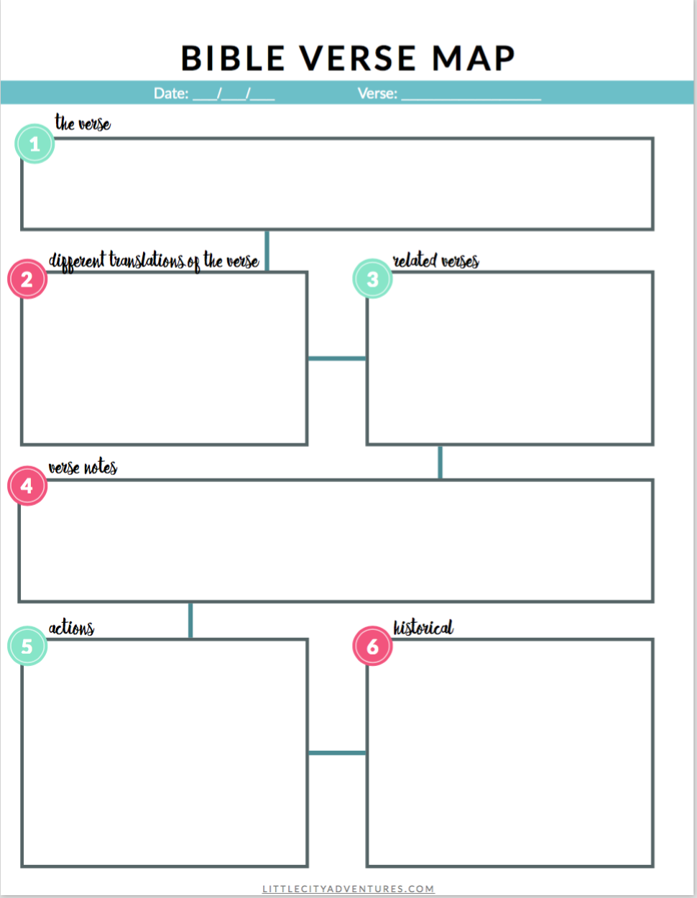
Template Examples

Slide 19
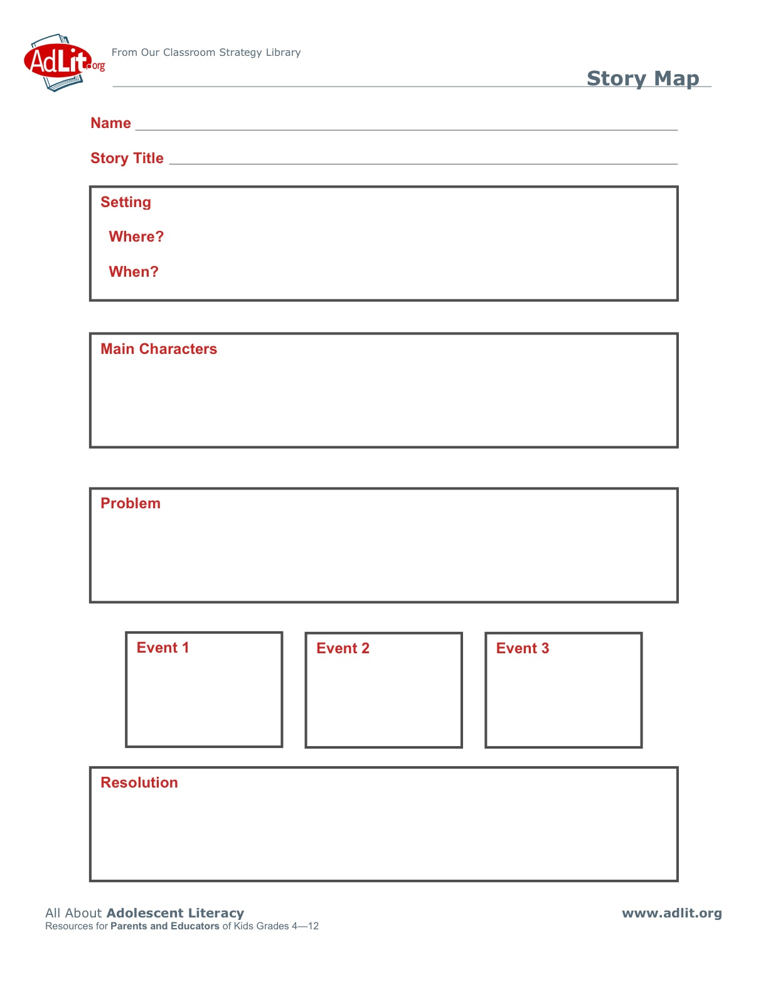

Slide 20
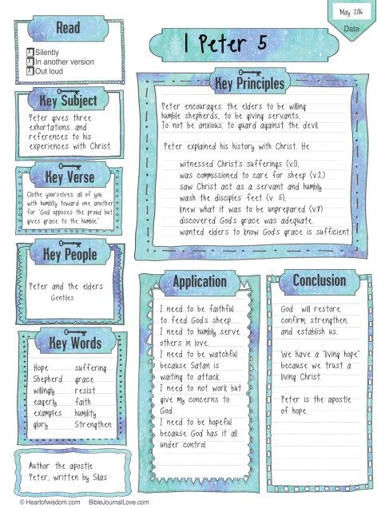

Slide 21
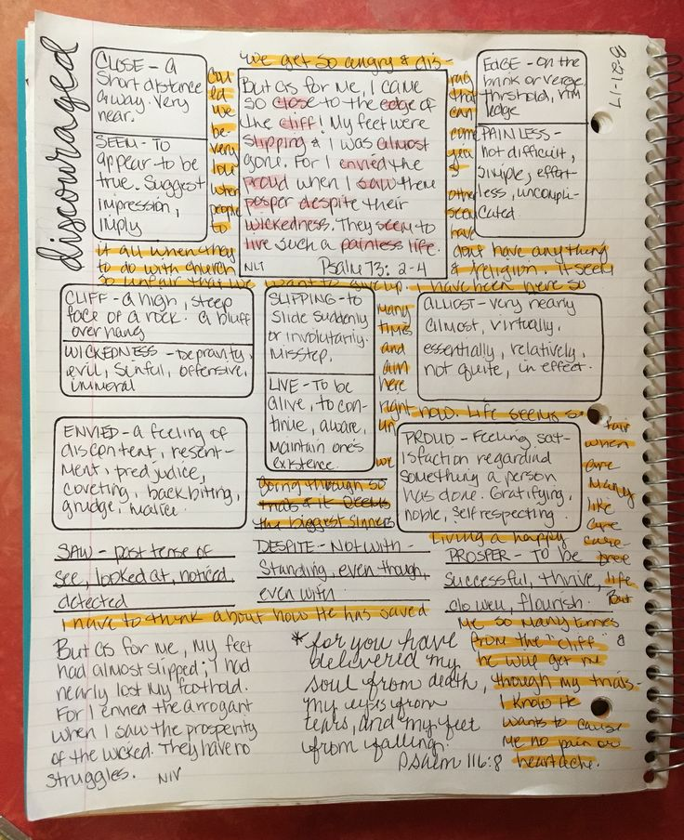

Slide 22
Group Study- Joshua 15: 13-19 (20 mins)
Study Points
Author/Audience
Translations & Paraphrases
Event/Theme of Passage
Meanings of Names & Places (including other mentions in scripture)
Relationships
Occupation/s
Context-Who, What, Where, When, How, Why
Key Words, Phrases
Cultural References
Online Resources & References
And unto Caleb the son of Jephunneh he (Joshua) gave a part among the children of Judah, according to the commandment of the Lord to Joshua, even the city of Arba the father of Anak, which city is Hebron.
¹⁴ And Caleb drove thence the three sons of Anak, Sheshai, and Ahiman, and Talmai, the children of Anak.
¹⁵ And he went up thence to the inhabitants of Debir: and the name of Debir before was Kirjathsepher.
¹⁶ And Caleb said, He that smiteth Kirjathsepher, and taketh it, to him will I give Achsah my daughter to wife.
¹⁷ And Othniel the son of Kenaz, the brother of Caleb, took it: and he gave him Achsah his daughter to wife.
¹⁸ And it came to pass, as she came unto him, that she moved him to ask of her father a field: and she lighted off her ass; and Caleb said unto her, What wouldest thou?
¹⁹ Who answered, Give me a blessing; for thou hast given me a south land; give me also springs of water. And he gave her the upper springs, and the nether springs.

Slide 23
Summarizing
Answers:
Joshua/Historical Account for the people of Israel
Favorite?
Begins to tell the story of the conquering of the promised land
Hebron, Debir, Kirjath Sepher, Achsah, Othniel
Family connections
Occupations, Interests
Context
Who is the story about?
What is happening?
Where is it happening?
When is it happening?
How is it happening?
Why is it happening?
Key Words,Phrases – Southland, Lighted off her donkey, Upper springs, Lower springs
Cultural References – Asked audience thru husband, dismounted
Online Resources – What did you learn?
Questions:
Author/Audience
Translations & Paraphrases
Event/Theme of Passage
Meanings of Names & Places
Relationships
Occupation/s
Context-Who, What, Where, When, How, Why
Key Words, Phrases
Cultural References
Online Resources & References
Notes:
1. Story was the recounting of the beginning of the battles for the promised land as told by Joshua or his scribe (not sure exactly who wrote the book) for the people of Israel.
2. Read Message Translation
Joshua 15:13-19 The Message (MSG)
¹³ Joshua gave Caleb son of Jephunneh a section among the people of Judah, according to God’s command. He gave him Kiriath Arba, that is, Hebron. Arba was the ancestor of Anak.
¹⁴⁻¹⁵ Caleb drove out three Anakim from Hebron: Sheshai, Ahiman, and Talmai, all descendants of Anak. He marched up from there against the people of Debir. Debir used to be called Kiriath Sepher.
¹⁶⁻¹⁷ Caleb said, “Whoever attacks Kiriath Sepher and takes it, I’ll give my daughter Acsah to him as his wife.” Othniel son of Kenaz, Caleb’s brother, took it; so Caleb gave him his daughter Acsah as his wife.
¹⁸⁻¹⁹ When she arrived she got him to ask for farmland from her father. As she dismounted from her donkey Caleb asked her, “What would you like?” She said, “Give me a marriage gift. You’ve given me desert land; Now give me pools of water!” And he gave her the upper and the lower pools.
3. Event/Theme of Passage:
4. Names
Hebron:join, fascinate, charm,
Debir: Oracle (the Word) pastureless Kirjath Sepher: (city of branches/book or CITY OF THE BOOK)
Achsah: Anklet/Tinkling Ornament (tradition says she was very beautiful, that she was a great reward) Caleb offered the most precious thing he possessed for the bravest warrior. She was a joy, an ornament, but much more than that. Her name tells us that she was very precious to Caleb.
Othniel: the Lion, Strength or Force of God
5. Family Connections (Othniel was Calebs Nephew, married his daughter, not sure if Calebs brother were born with different mothers or fathers-but Achsah and Othneil probably knew each other from family gatherings.
6. Occupations: Warriors, Fighters, Conquerors, Fearless & Faithful.
Cross reference: Judges 3:8-11, Othneil become a judge, the first judge in fact.
7. Context-
time of splitting up of the inheritance.
Caleb claims his portion
Caleb wants to conquer another city in his inheritance but he needs help. He offers the best that he can think of (his daughter) for the most courageous, strongest and bravest warrior. She inspired men to go to war.
Othniel answers the call.
They receive a dowry of land in addition to marriage. A dry desert.
They consult on what to do. They settle on Achsah asking something more from her father in addition to the field. She needs water to make it productive. Her families survival and her husbands reputation depend on it. Her husband arranges the meeting. (jesus arranges or interceeds with the Father for us)
Even though Caleb was her father, she approaches him with respect and humility. She was bold, yet respectful. Having faith that when there as a problem, her father was the one to help her solve it. She was her fathers daughter (Calebs past history and faithfulness and boldness)
Water was the most important need she had-she knew only her Father could provide it. (it was technically HIS WATER she wanted-it belonged in his land, his inheritance)
The water was in the city they just conquered. Debir was the city of 14 springs, over flowing with water. The battle provided what they needed.
8. Key Words/Phrases:
Southland: parched, dry, desert (most difficult field to work, was this a sign of disrespect to her and her husband? Or was a sign of trust, knowing they were capable of making it fruitful?)
Lighted off her donkey (came down of her high horse-sign of respect in ancient times
Upper Springs (source of the water, rushing rivers)
Lower Springs (pools, easy access, calm)
9. Cultural References: Submission to husband, dismounted (meaning in spiritual terms? Trust & teamwork, humility)
10. Online Resources: What did you learn? (achsah gets a bad rap…worman who wanted more, woman who was discontented, demanding, etc…

Slide 24
Application
What did this passage teach us about God?
What stood out the most to you?
What is happening in your life right now that helps you relate to this passage?
What has this study done for your faith?
Has scripture encouraged you?
Will you think/feel/do differently?
How can you share what you’ve learned?

Slide 25
Get Creative
Bible Verse Mapping is a great tool for incorporating other study methods. Some that you might want to include are:
Bible Journaling
Bible Coloring/Drawing/Art
Bible Marking
Scripture Memorization
Creative Organization
Bible Scrapbooking
Prayer Journaling
Other devotional materials-examples

