Slide 1
Facilitative Leadership
Module #2: Focus on Results, Processes and Relationships

Slide 2
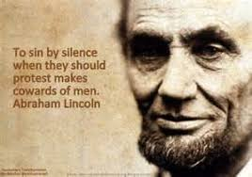
Tacit Approval in Leadership

Slide 3




Review Previous Session

Slide 4
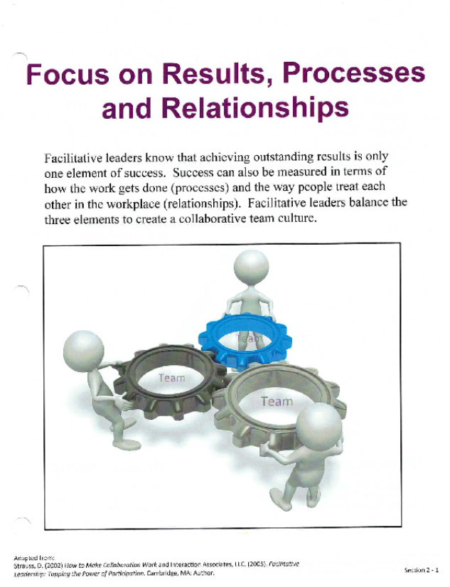
Focus on Results, Processes and Relationships

Slide 6
Measuring Success: Key Questions
Results
  Are the results of high quality?
  Are the results timely?
  Do results meet the requirements of the stakeholder group?

Slide 7
Measuring Success: Key Questions
Processes
  Are the processes clear and logical?
  Are the processes efficient?
  Are the processes appropriate for the task?

Slide 8
Measuring Success: Key Questions
Relationships
  Do team members feel supported?
  Do team members trust each other?
  Do team members feel valued?

Slide 9
Reflect and Share
Think about your leadership style as it relates to the three elements of leadership: Results, Processes, Relationships
Which of the three is a strength?
Which one needs more of your attention?
Share with your partner

Slide 10

Work with a partner

Slide 11






Slide 13
Exercise: Teams and Teamwork
Complete the 6 questions
Work with a partner to compare responses
Combine responses and eliminate duplicates

Slide 14
High Performing Teams

Slide 15

Connect, Reflect and Summarize

Slide 16
Bonus Material

