Slide 1
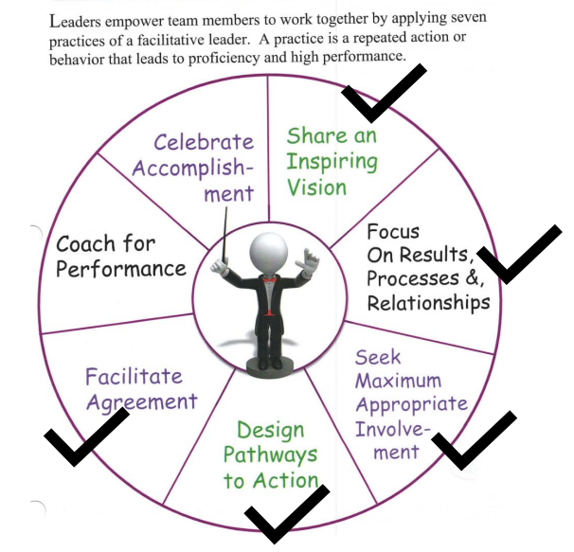
Seven Practices of a Facilitative Leader

Slide 2
Coach For Performance
Coaching is a conversation wherein one person (the coach) instructs, counsels, and tutors another (the coachee) in how to improve performance. Effective coaching yields more than improved performance; it also increases personal satisfaction, inspires a commitment to excellence, and fosters the coachee's development as a leader.

Slide 3
Reflect and Write: When I envision an effective coaching conversation, it. . .
Looks like
Sounds like
Feels like

Slide 4
Coaching Conversations
Type | Purpose
Feedback | To reinforce or change a specific pattern of behavior
Problem-solving | To figure out the best approach for solving a problem, pursuing an opportunity, or producing a specific result
Development | To define the coachee's professional or personal aspirations and explore alternative pathways for realizing those aspirations.

Slide 5
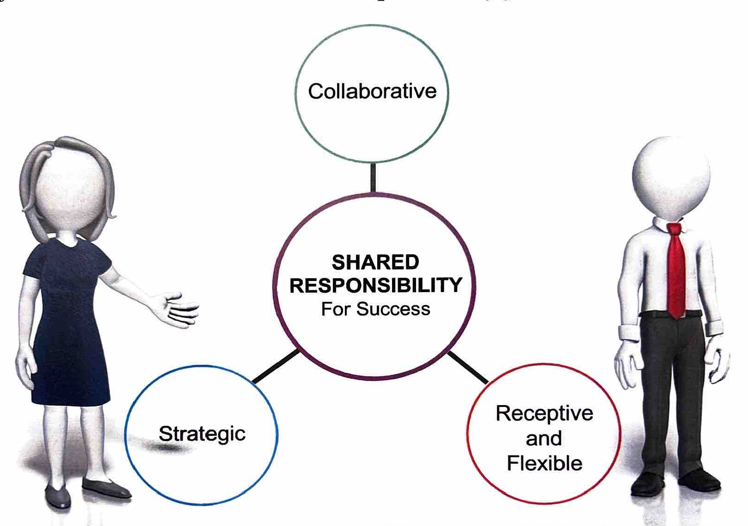
Attributes of Effective Coaching Conversations

Slide 6
Definition: Inquiry vs Advocacy
Inquiry: "an act of asking for information."
Advocacy: "any action that speaks in favor of, recommends, argues for a cause, supports or defends, or pleads on behalf of others."

Slide 7
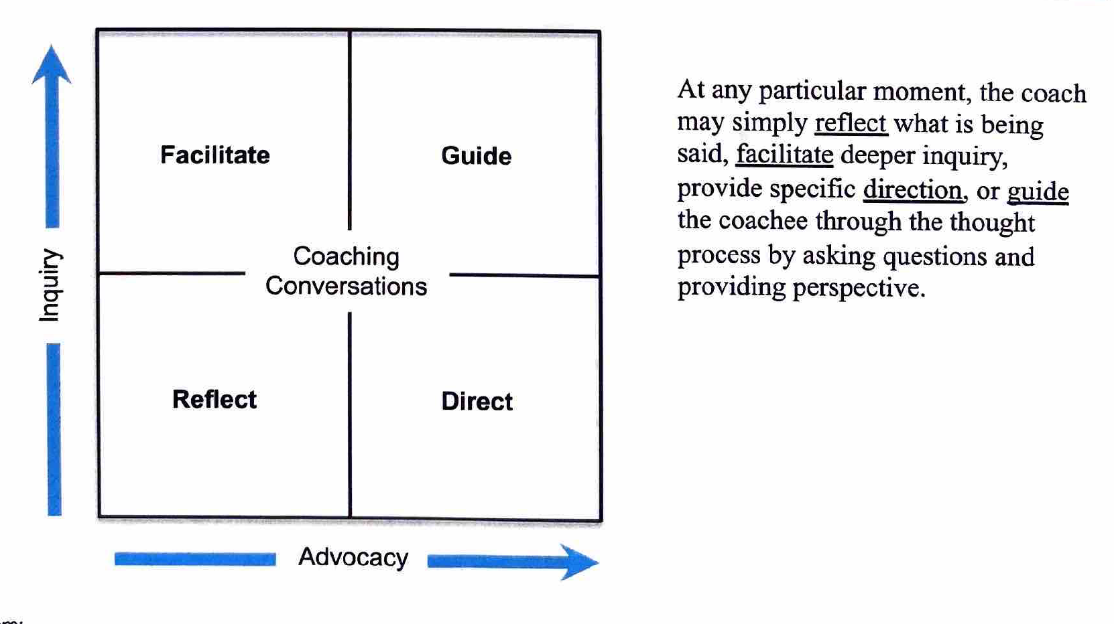
The Coaches Toolkit: Inquiry and Advocacy

Slide 8
Inquiry Techniques
Bracket: To create an open mind so you can listen, free your own filters to the other's point of view.
Paraphrase: Listen to key phrases and words and then restate them using your own words.
Check Perceptions: If you pick up any unspoken assumptions, conclusions or feelings the coachee may have, name the and ask if your perceptions are correct.
Ask Probing Questions: Ask basic questions using "who," "when," "where," or "how."

Slide 9
Advocacy Guidelines
Acknowledge the coachee's situation: "I understand that your new assignment to a one-room school is very demanding. Having been a one-room school teacher, I know the pressure can be enormous."
State your advocacy: "Based upon your description of the problem, and the possible root causes we have uncovered together. I encourage you to engage board members and church members in a shared responsibility of the school"

Slide 10
Advocacy Guidelines Cont. . .
Outline the data and explain the reasoning behind your advocacy: I recommend that course of action for three reasons: One. . .
Check for understanding: "Before either of us makes any comments on what I have said, is there anything you did not understand?"
Encourage inquiry and alternative points of view: "I would like to hear wheat questions or concerns you have about what I am suggesting. Perhaps you have a different point of view or proposed Action."

Slide 11
Bonus Slide

